Slide 1
IOT Project
RFID SMART
HEALTH CARD
Group Members:
Shubham kumar
Pradeep kumar

Slide 2
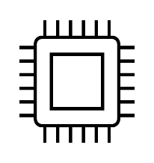
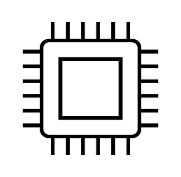
INTRODUCTION
RFID SMART Health Cards are digital versions of clinical informations.
RFID SMART Health Cards are easily portable.
Records can be maintained easily over a longer period of time.
Records of the patients are not lost since they are permanently present in the database.
If their respective account is signed up with the new card, their records are backed up to the new card.

Slide 3
OBJECTIVES
Smart health cards can improve the security and privacy of patient information.
Provide the secure carrier for portable medical records.
Support new processes for portable medical records.
Provide fast and secure access to emergency medical information.
Enable compliance with government initiatives and mandates.
Provide the platform to implement other applications as needed by the healthcare organization.

Slide 4
FEATURES
Scanning of a RFID card will result in blinking of a LED indicating successful scanning of the card.
Admin can use the data to see the medical history of the patient on the website portal.
Bar graph of common diseases and registered blood groups can be also seen in the “Analysis” tab.
Admin can “edit” or “delete” the record of the required user/patient.
RFID card will be unique to each patient’s data and can be easily scanned within frequency range of
the RFID card reader module.
New registration of user/patient will be easily done using a proper neat Interface.

Slide 5
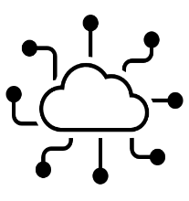
Software Requirements:
OS: Microsoft Windows 10(64 bits) and above.
Language: C(Arduino),PHP,HTML,CSS.
Text editor: visual studio
Database: MySQL
Server: XAMPP Server (phpMyAdmin)

Slide 6
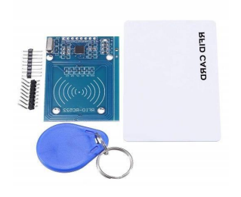
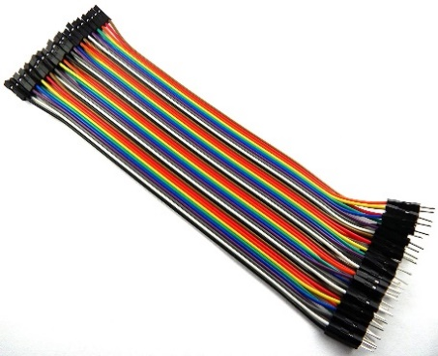
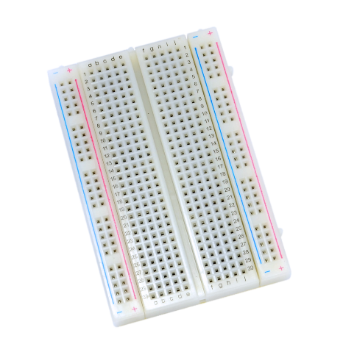
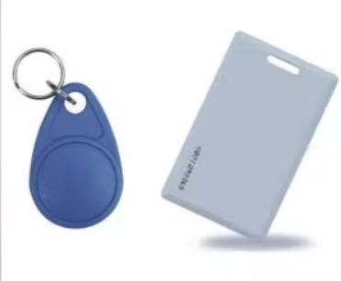
Hardware Requirements:
NodeMCU 1.0 (ESP-12E module) board
RC522 RFID Card Reader Module
Jumper wires
Breadboard
RFID Card or Key chain

Slide 7
FUNCTIONAL REQUIREMENTS NON-FUNCTIONAL REQUIREMENTS
Login Usability
Authentication Reliability
Validation Performance
Classification
Display medical data of user/patient.

Slide 8
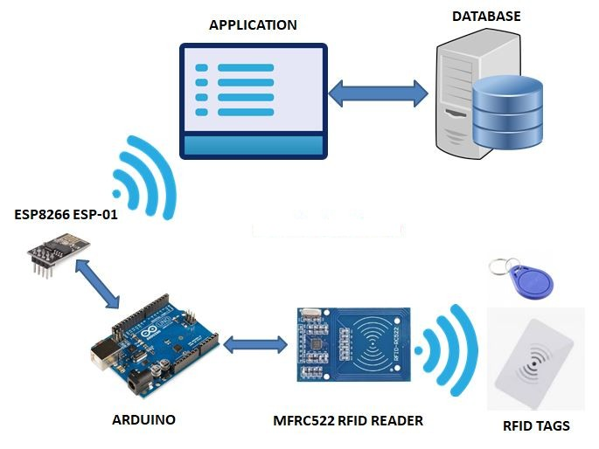
IMPLEMENTATION DESIGN

Slide 9
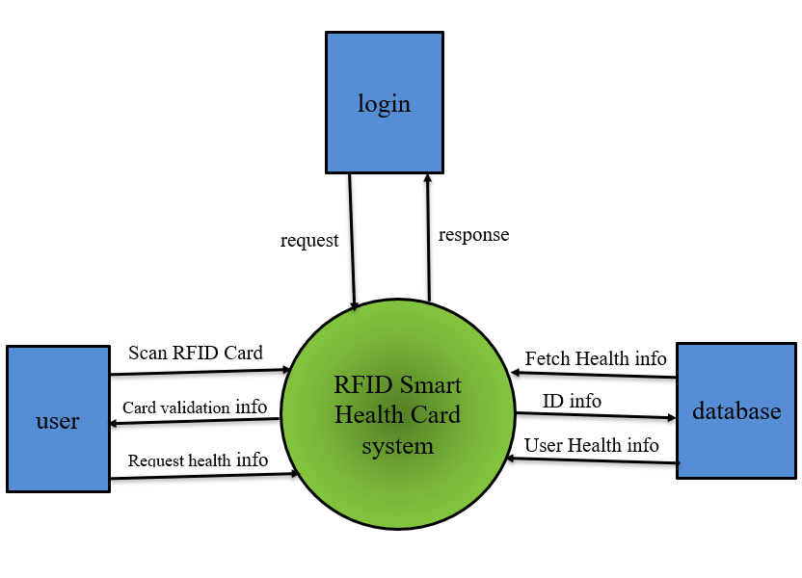
DATA FLOW CONTROL

Slide 10
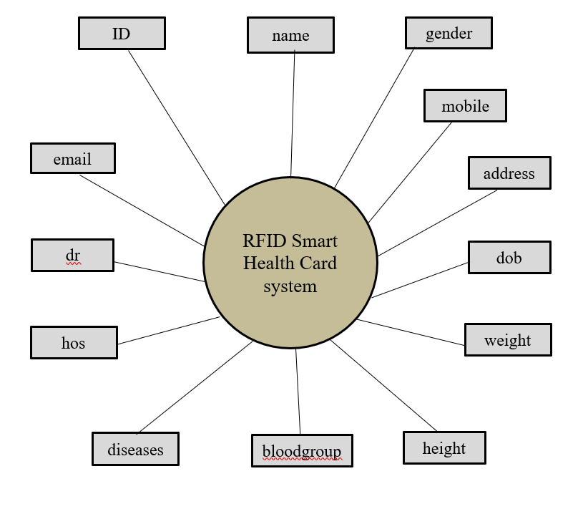
DATABASE DESIGN (Entity Relationship Diagram)

Slide 11
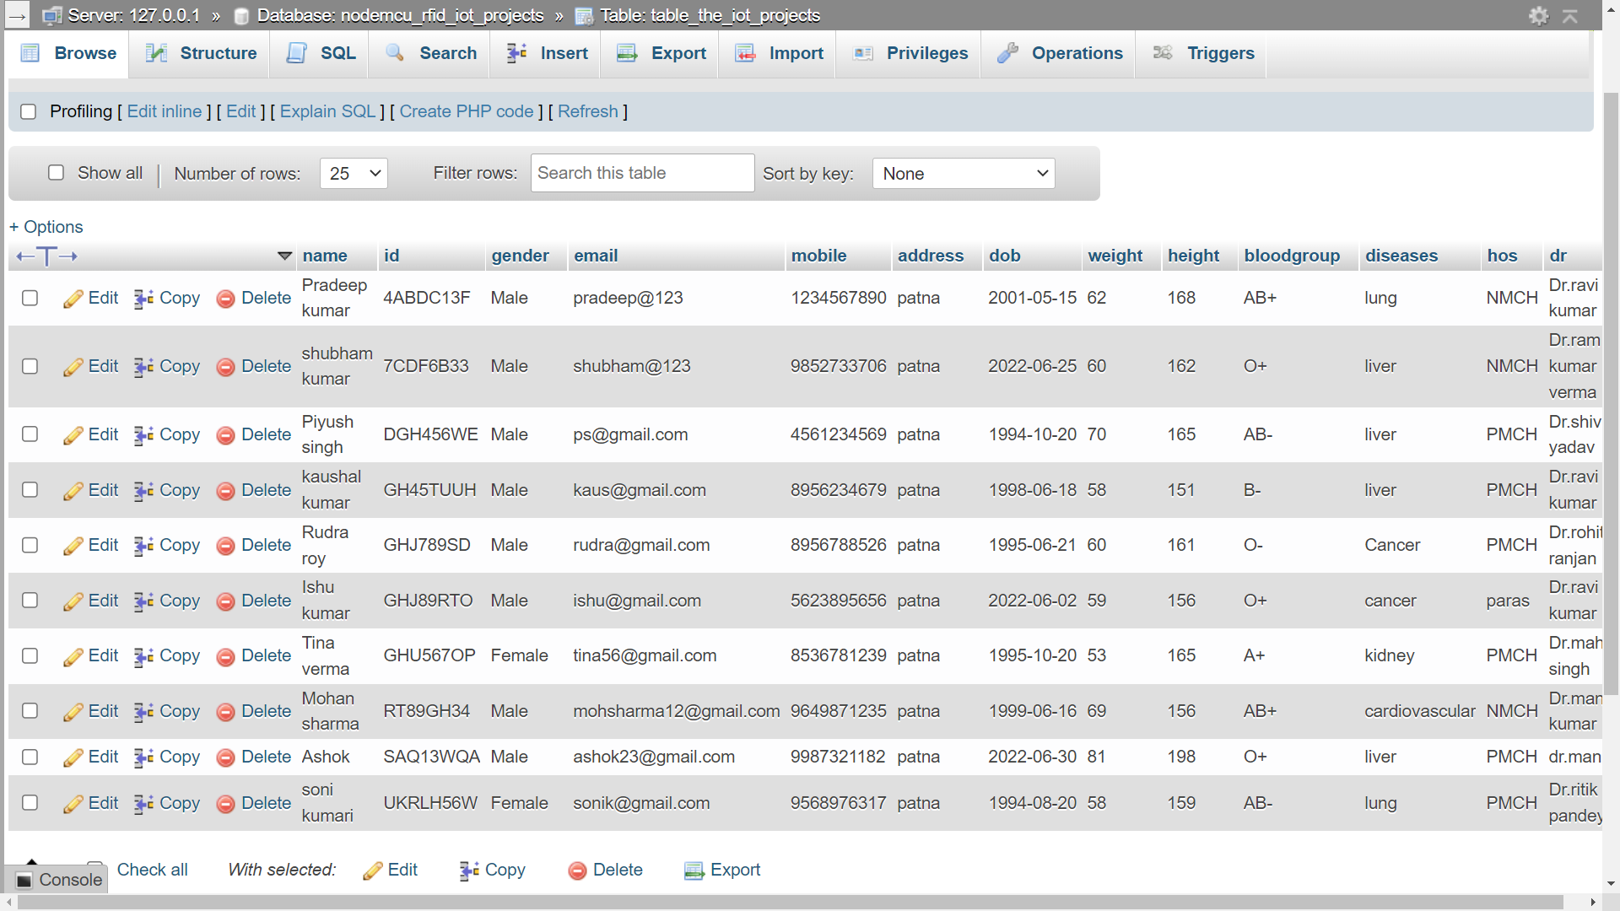
DATABASE TABLE

Slide 12
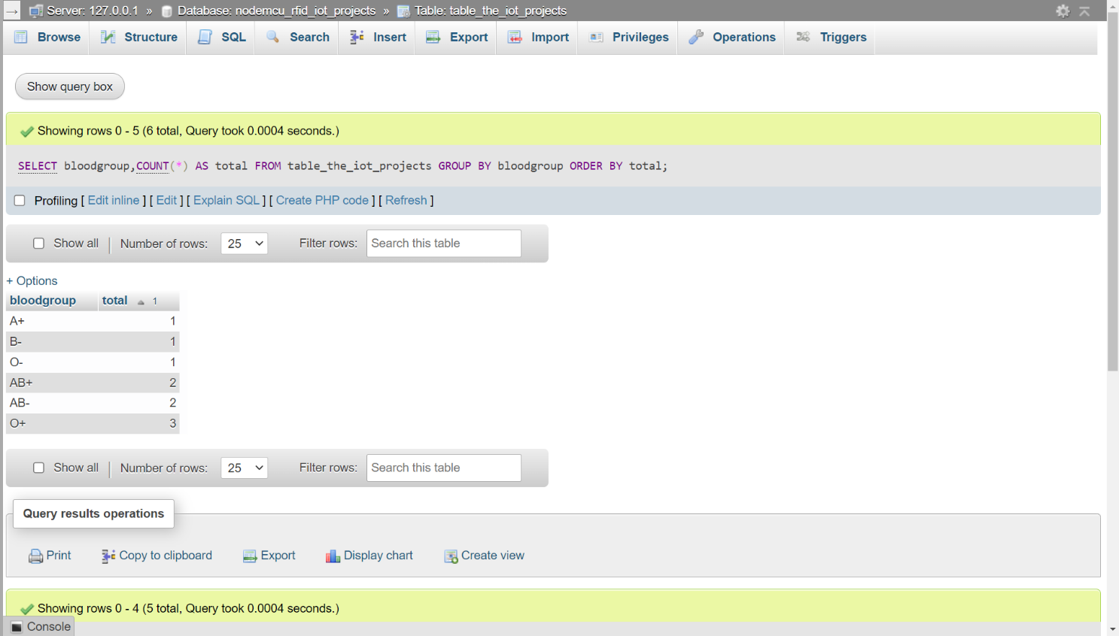
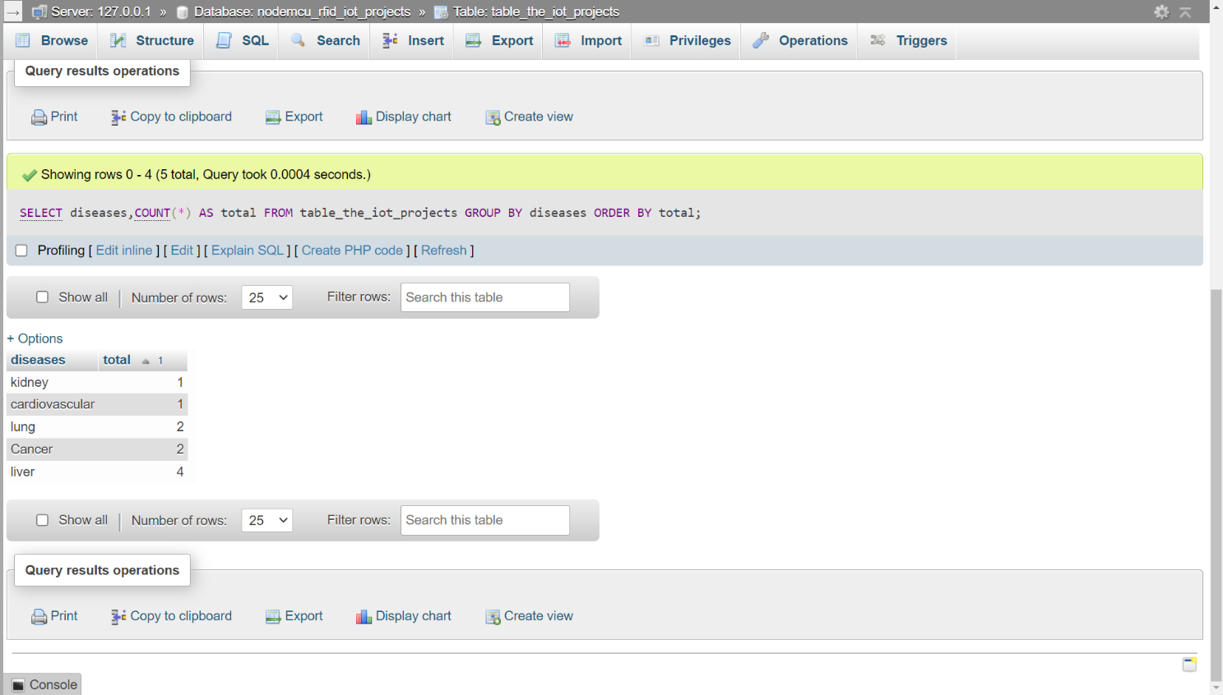

Slide 13
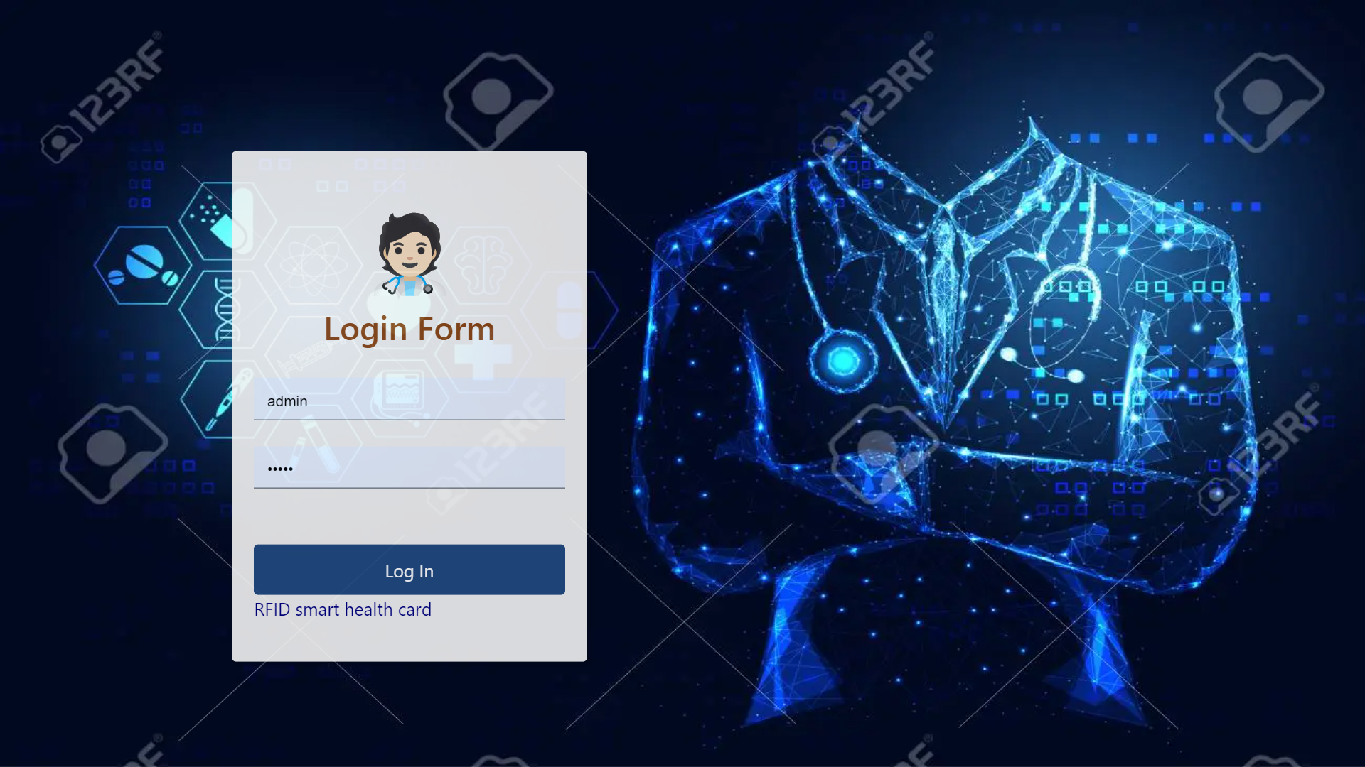
INTERFACES
A. User Interfaces
a. Index Login Page

Slide 14
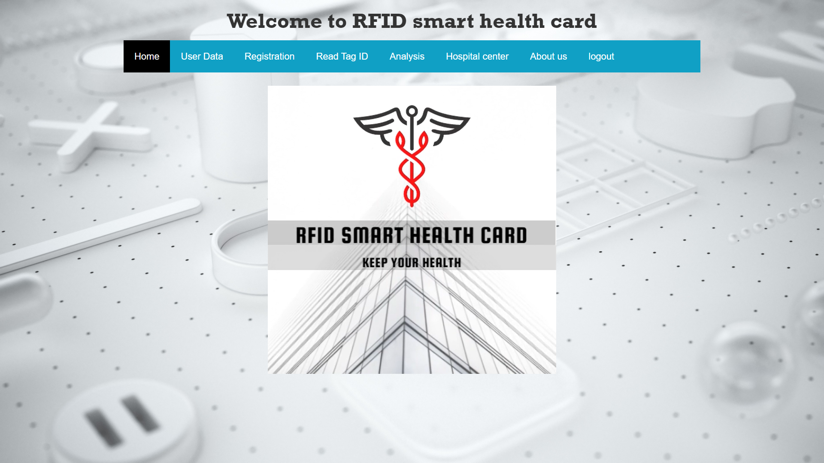
INTERFACES
A. User Interfaces
b. Home Page

Slide 15
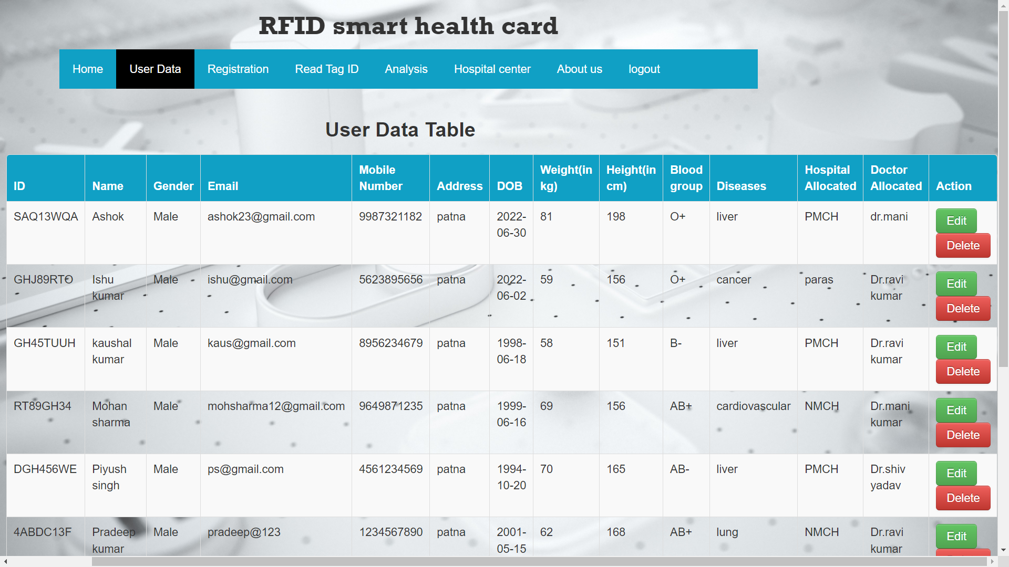
INTERFACES
A. User Interfaces
c. User Data Page

Slide 16
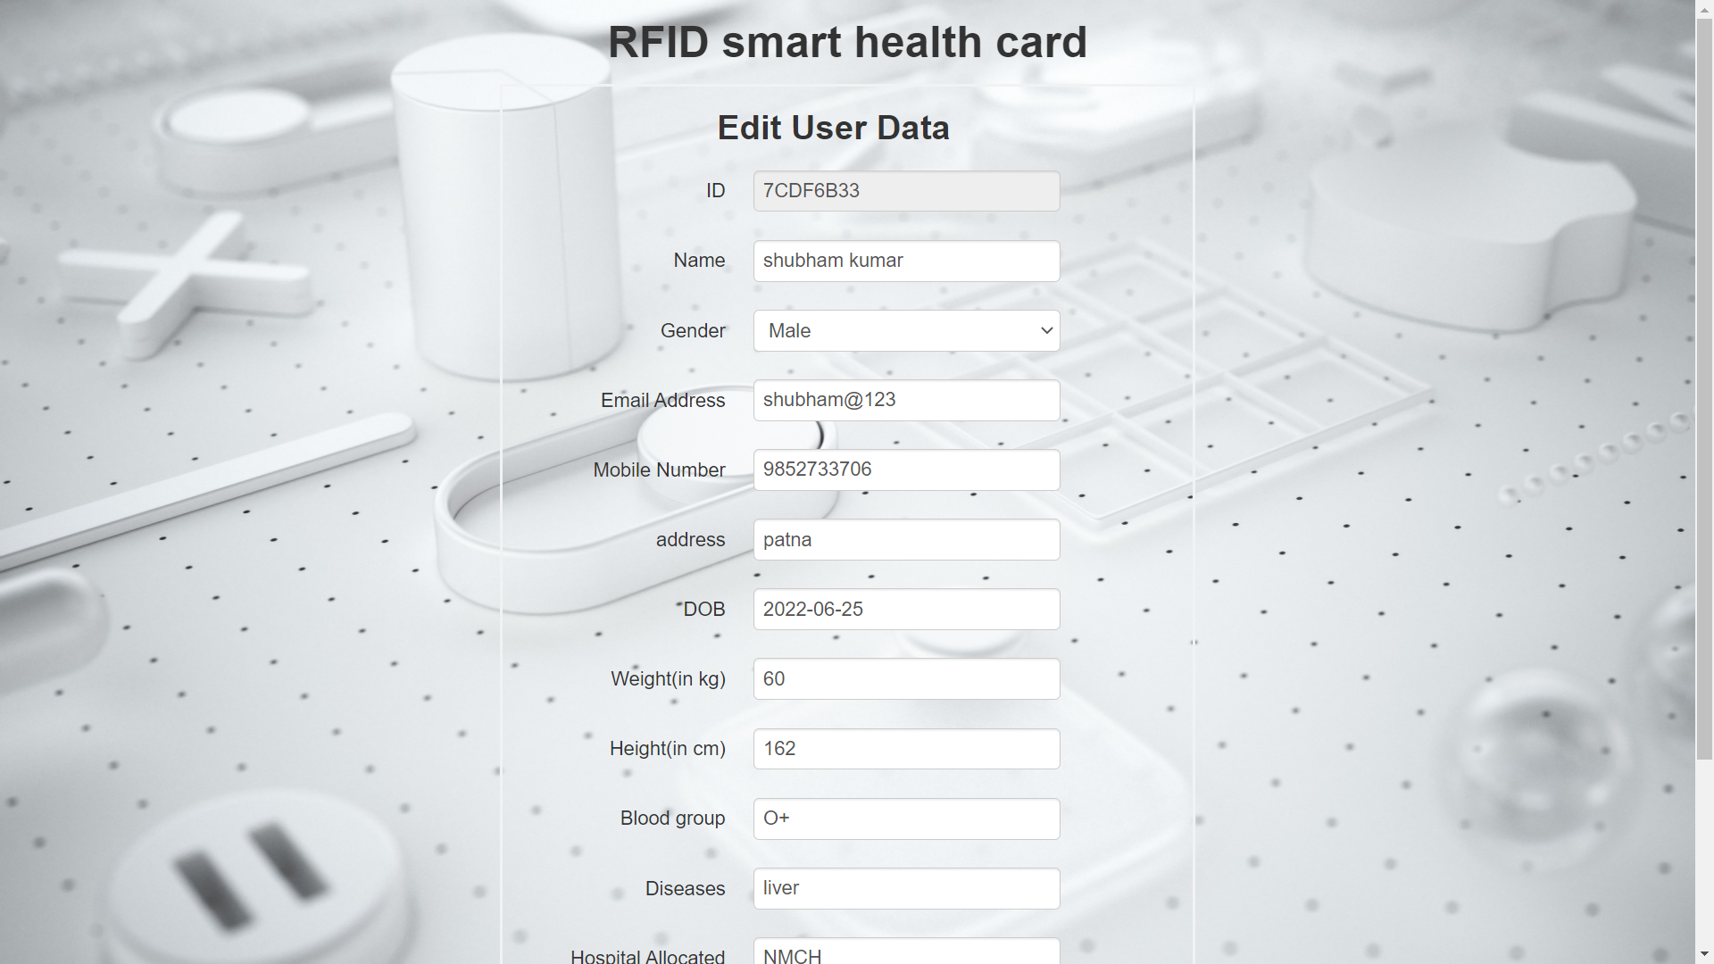
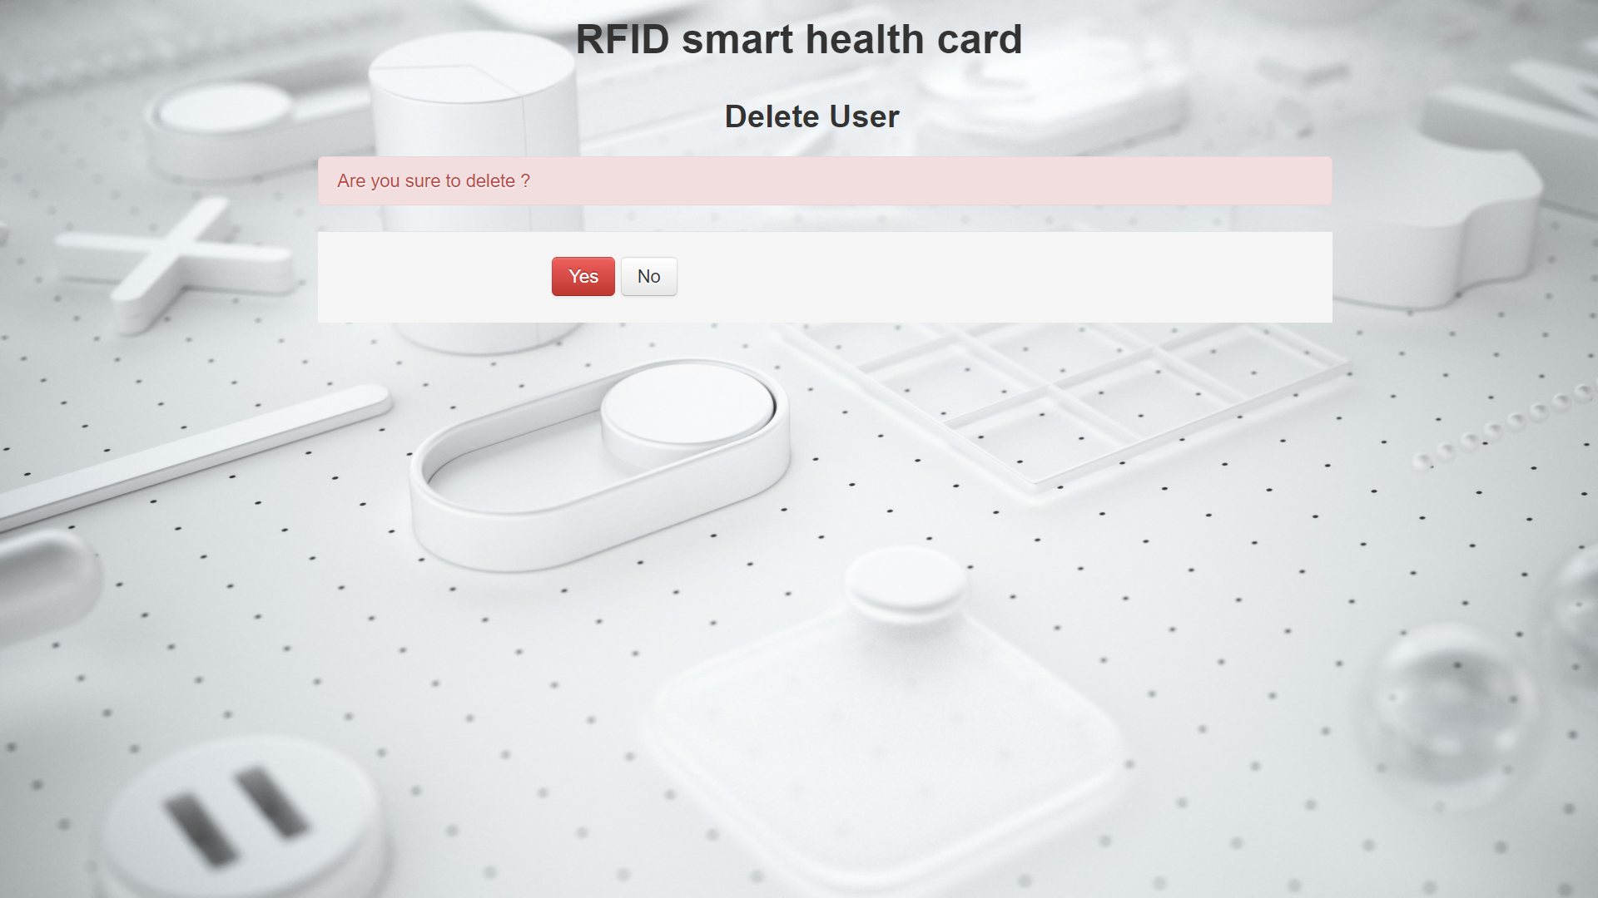
INTERFACES
A. User Interfaces
d. User Data Edit Page
e. User Data Delete Page

Slide 17
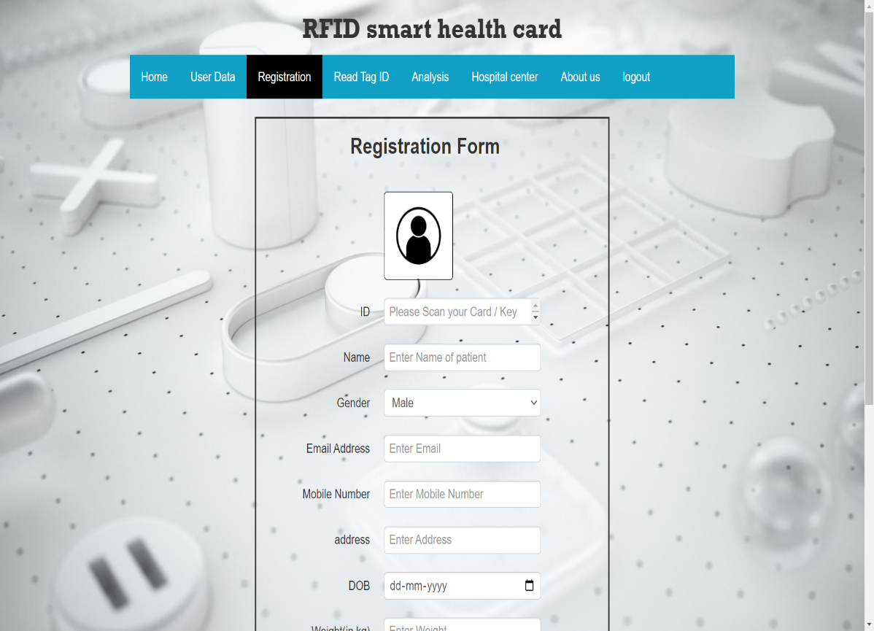
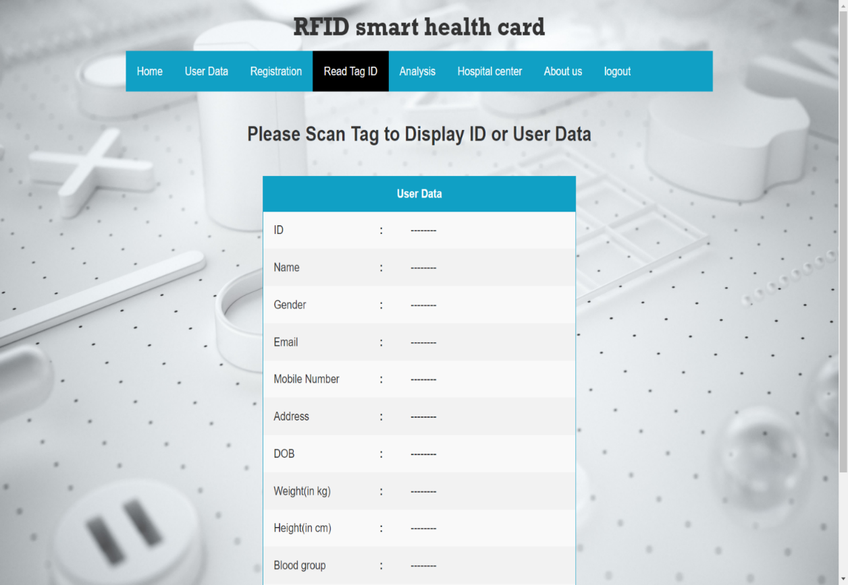
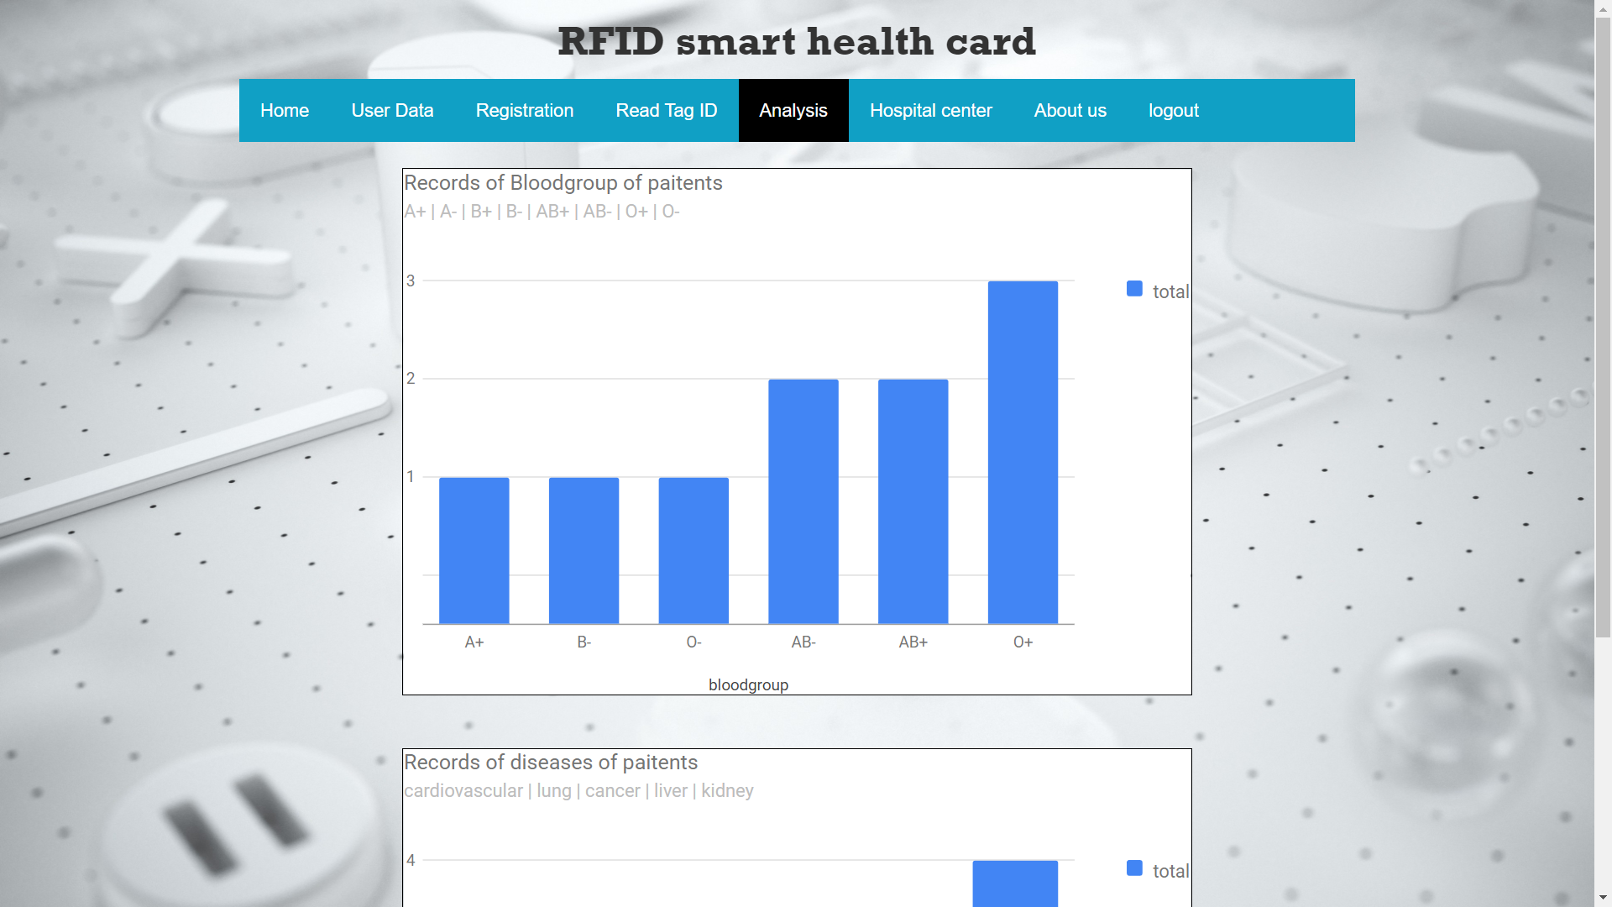
INTERFACES
A. User Interfaces
f. Registration Page
g. Read Tag ID Page
h. Analysis Page

Slide 18
INTERFACES
A. User Interfaces
i. User Data Edit Page
j. User Data Delete Page

Slide 19
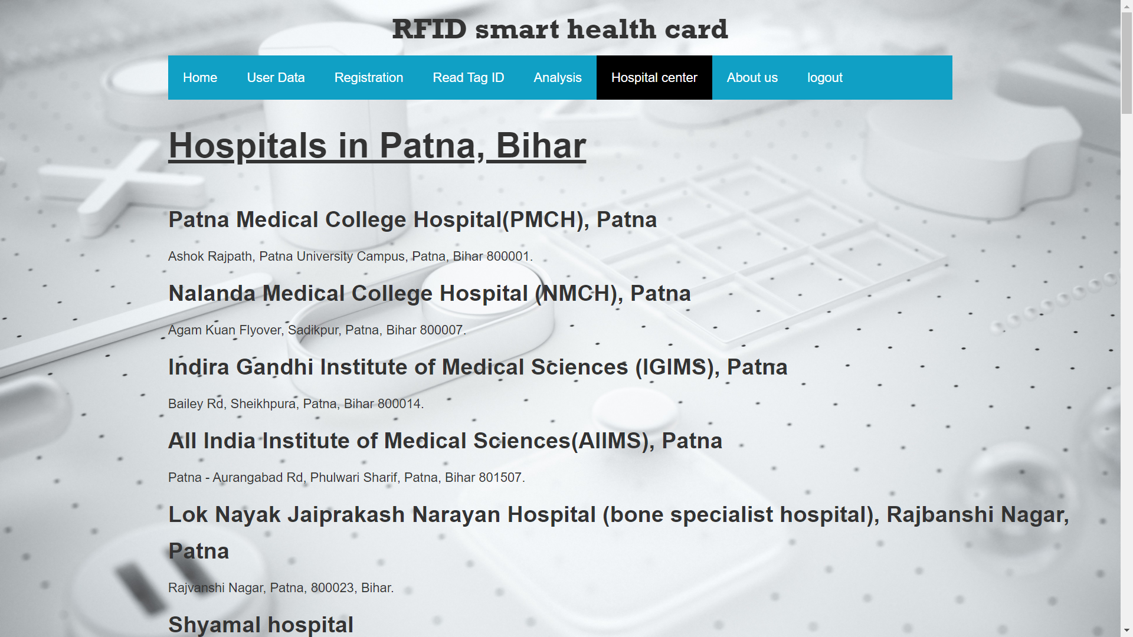
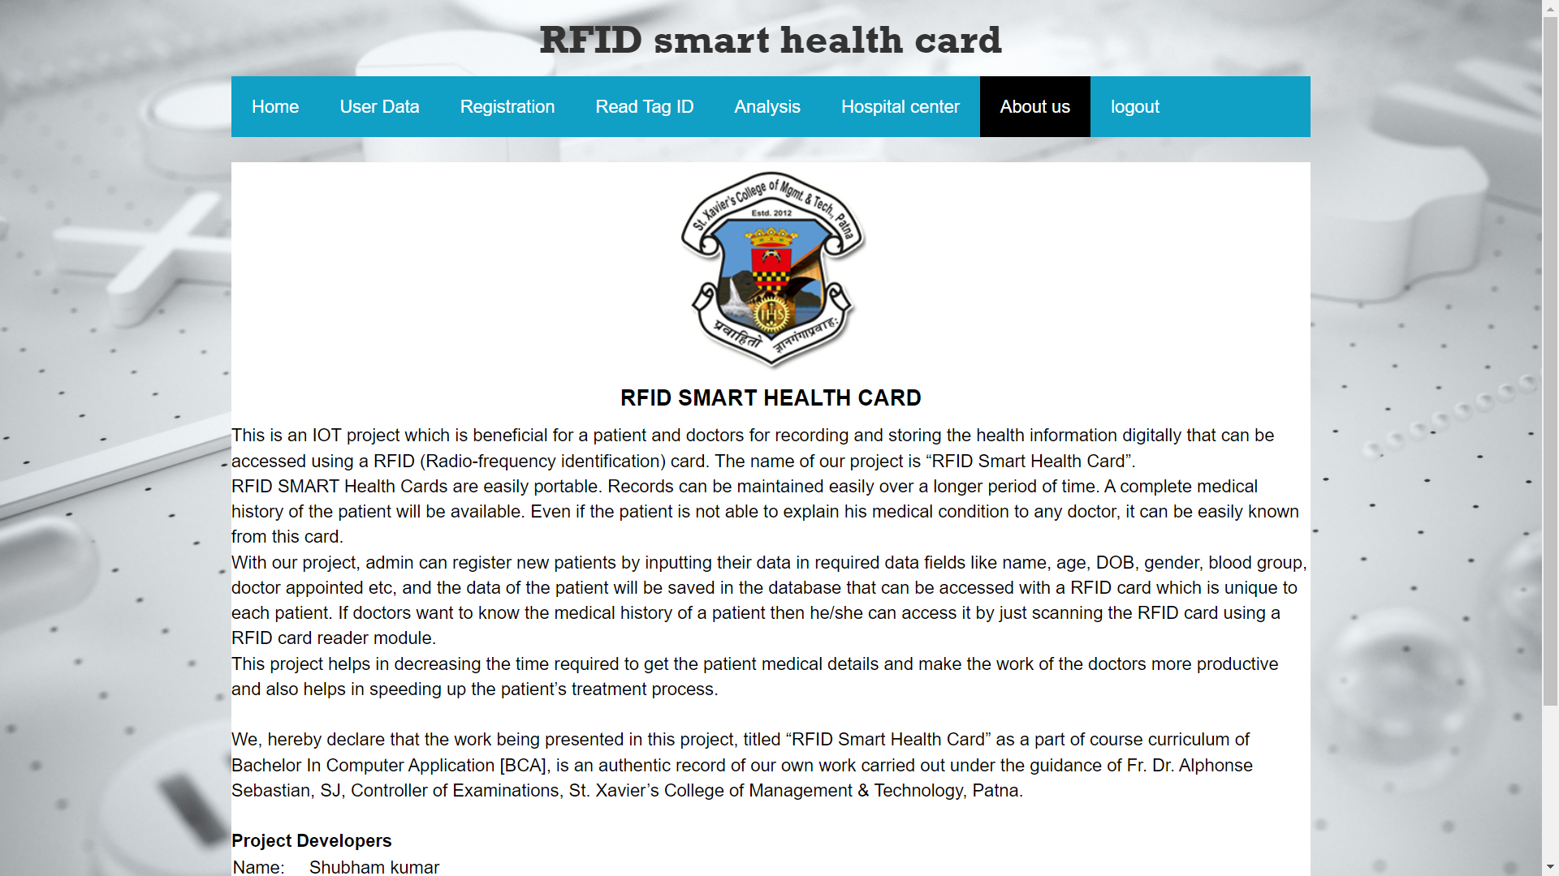
INTERFACES
A. User Interfaces
i. Hospital Centre Page
j. About Us Page

Slide 20
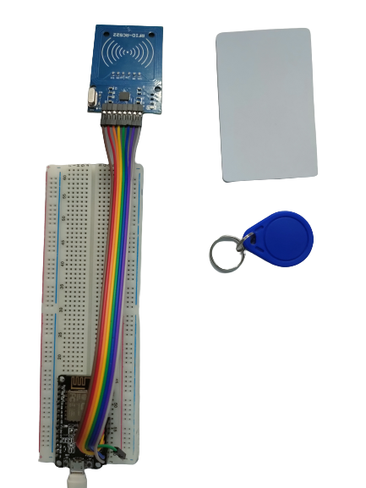
INTERFACES
B. Hardware Interface

Slide 21
Interfacing RFID RC522 with NodeMCU ESP8266 Module
NodeMCU ESP8266/ESP12E <———-> RFID MFRC522 / RC522
D2 <———-> SDA/SS
D5 <———-> SCK
D7 <———-> MOSI
D6 <———-> MISO
GND <———-> GND
D1 <———-> RST
3V/3V3 <———-> 3.3V

Slide 22
Limitations
RFID cards are small and light-weighted. It may be lost or forgotten in case of any use so, we need
backups in advance.
The biggest problem facing smart cards is their level of security.
Requires high speed of internet connectivity.
Electric RFID systems may malfunction during power outages.
Materials like metal & liquid can impact signal.
Cost – RFID readers can be 10x more expensive than barcode readers.

Slide 23
Future Scope
Future Scope of RFID Smart Health Card in future
Reporting and Monitoring Cost Reduction in healthcare
Connectivity and Affordability Improved Treatment
Analysis and Data Assortment Faster Disease Diagnosis
Alerts and Tracking Drugs and Equipment Management
Remote Medical Assistance
Research

Slide 24
CONCLUSION
RFID Technology brings a quick and easy to authenticate and display medical information.
It has many other applications in Research & Development.
Digital health cards proves to be a beneficial for a productive medical health checkup.
It can be implemented in variety of places for making smart systems.
It is helpful in critical situations where it is the need of the hour.

Slide 25


